Slide 1
Computing is easy
PH200A Biostatistics Small Group Session
Mitchell Schepps
maschepps@ucla.edu

Slide 2
Goal for some of you:
“I remember my biostats class”
See how a statistical analysis is run
All code WILL be provided
Lots of help/consulting available

Slide 3

One line of code is a lot
Computer language = Adult calculator
Plots are made in computer languages
Statistical analyses and data are reproducible
Lab to lab
Open data

Slide 4
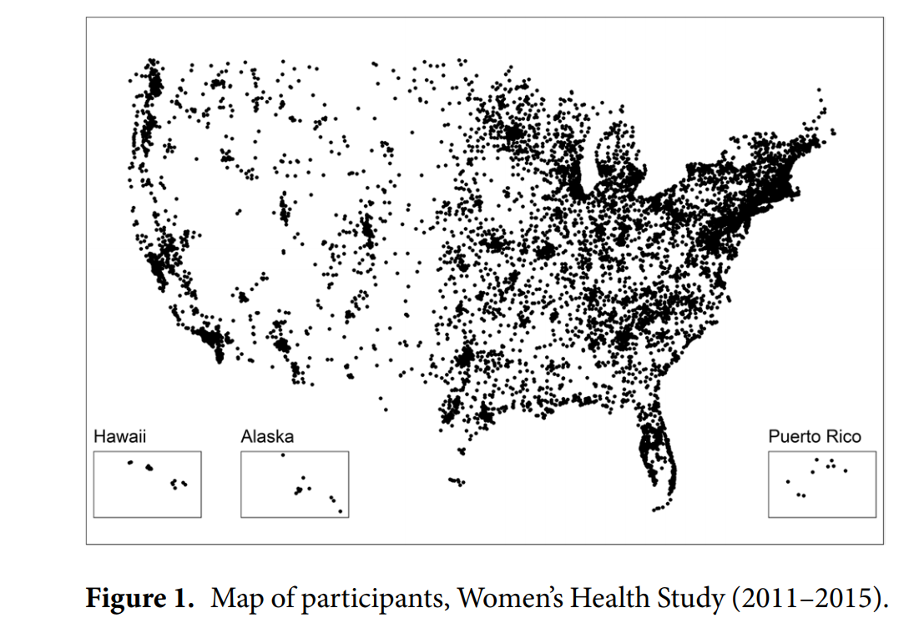
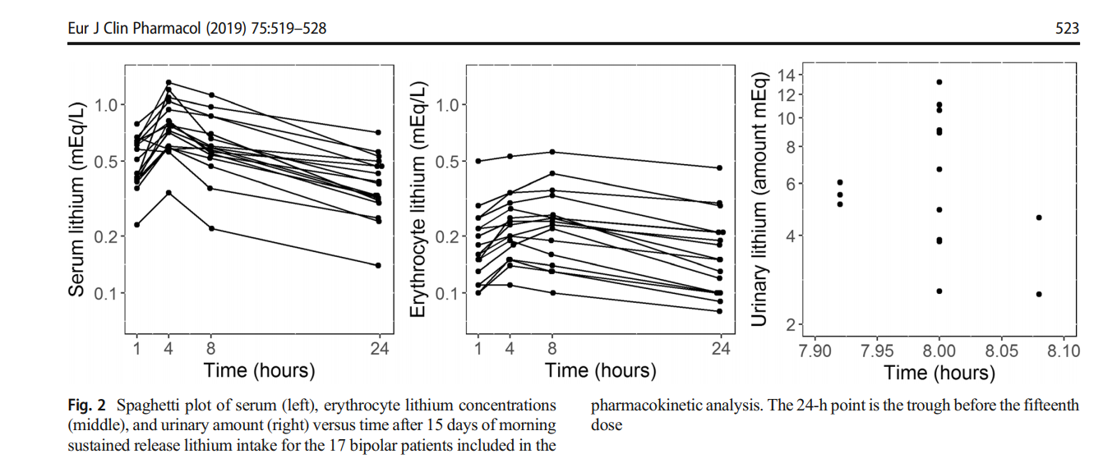
Examples of plots from code
Map of “Fitbit” Participants
Sustained Release Lithium for Bipolar Disorder

Slide 5
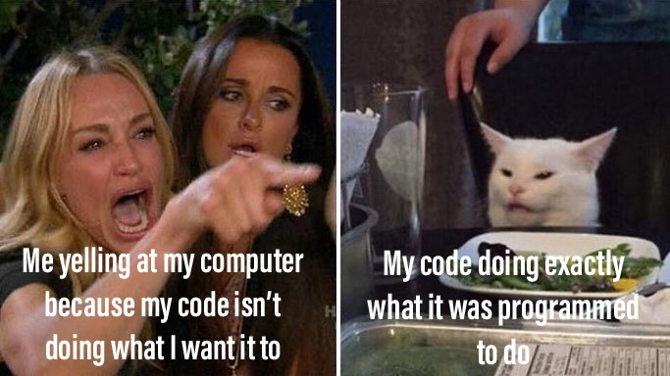


You will mess up
Code never works the first time
Often times, you are missing a comma
Or a parentheses

Slide 6
Github.com/hopeful-coder/PH200A
Follow Along
If you want to follow along, please go to this link: Github.com/hopeful-coder/PH200A

Slide 7
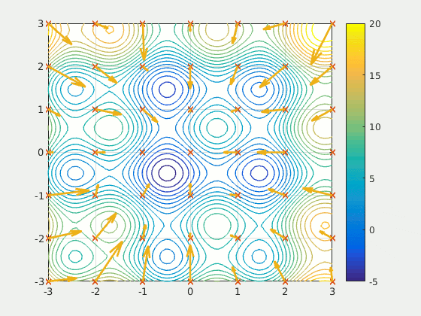
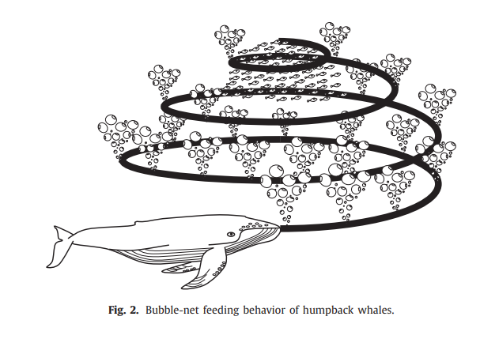
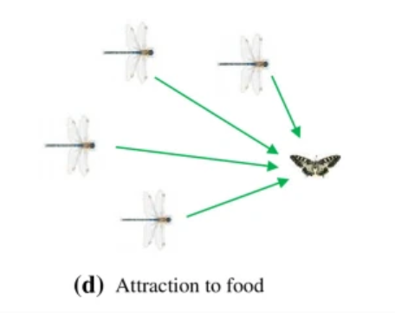
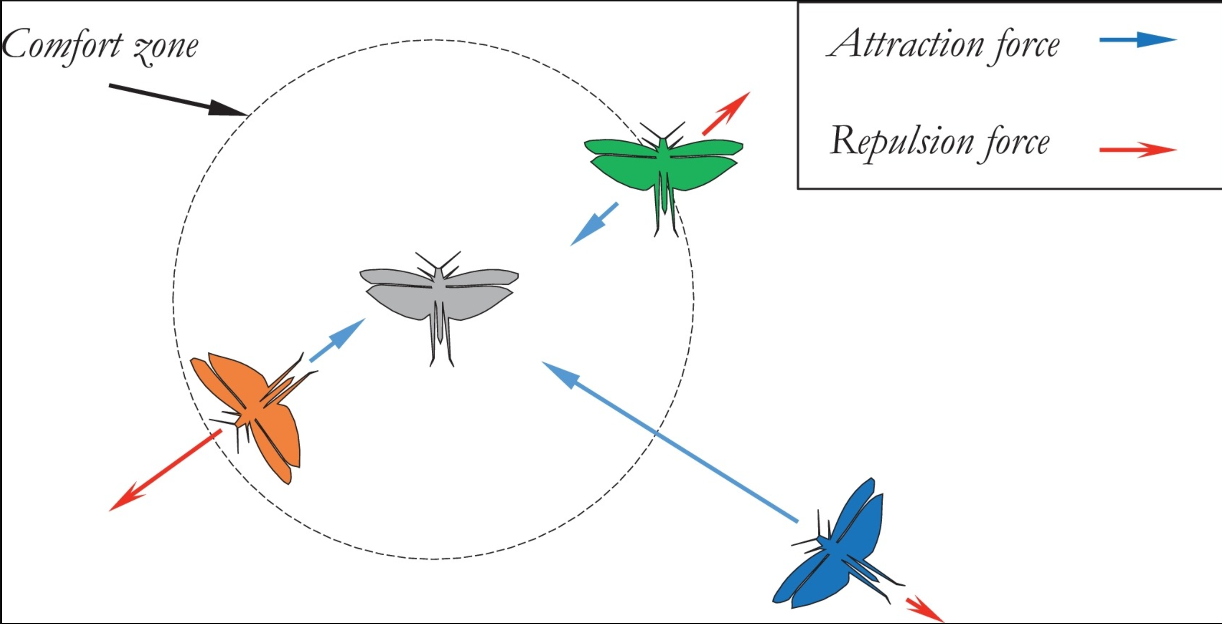
Metaheuristics
Natural behaviors search the space for the best optima.
Exploration – Search the space for a good solution
Communication – Transfer information between other members of the search
Exploitation – Intensely search a good area.

Slide 8
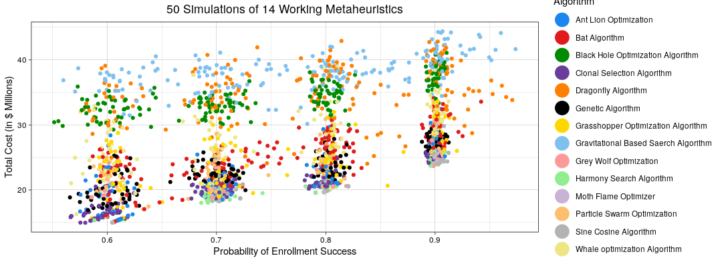
4. Results from 50 runs of each metaheuristic
Notes:
Given each run is very variable, we cannot say much about. Costi s about the same. Politicial decision.

Slide 9
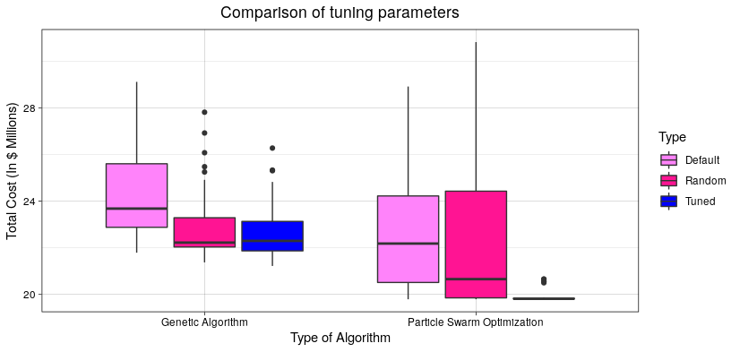
5. Racing Algorithm Results
Tuning result after 50 simulations
Tuning Parameter | Range | Default | Tuned
PSO.PBest | 0 – 60 | 1.465 | 26
PSO.GBest | 0 – 60 | 1.012 | 1
PSO.Vmax | 0 – 100 | 2 | 86
GA.M | 0 – 1 | 0.1 | 0.4
GA.C | 0 - 1 | 0.8 | 0.9

Slide 10
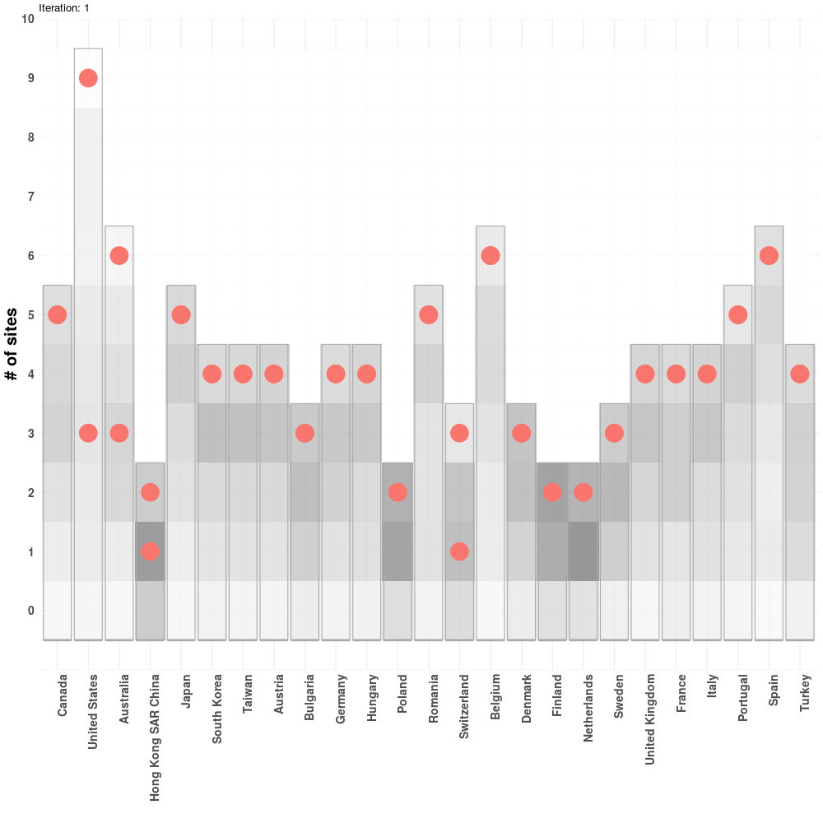
What is the best answer?
Global patient Enrollment optimization

Slide 11
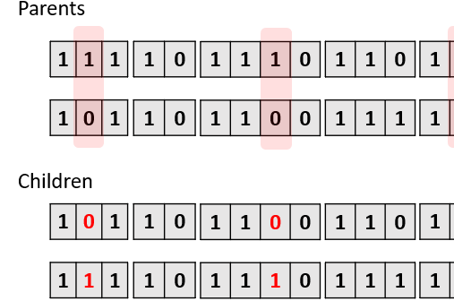
Racing Algorithm
Genetic algorithm
Ranks binary representations of sites
“Speed parameters” are
P_{m} = Probability of Mutation
P_{c} = Probability of Crossover

Slide 12
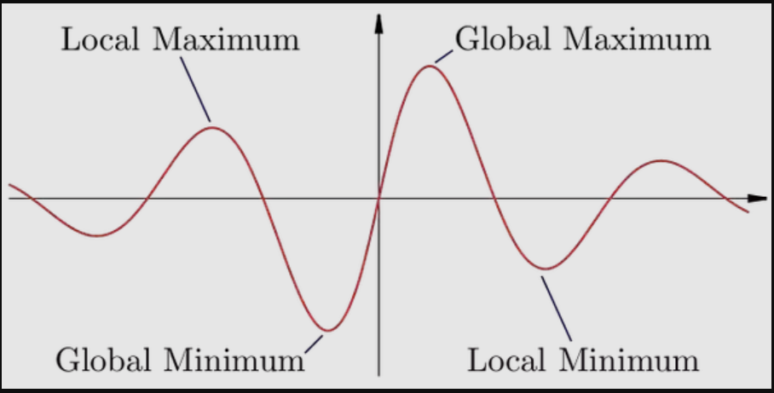
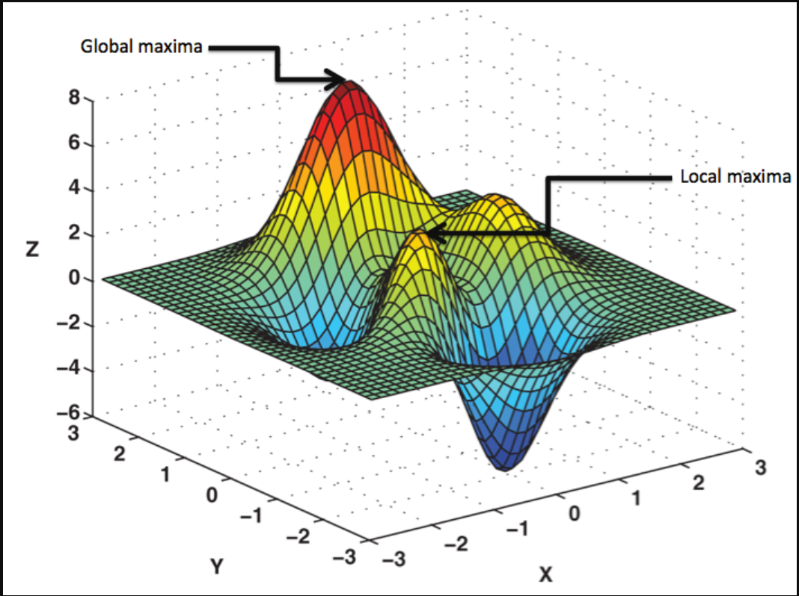
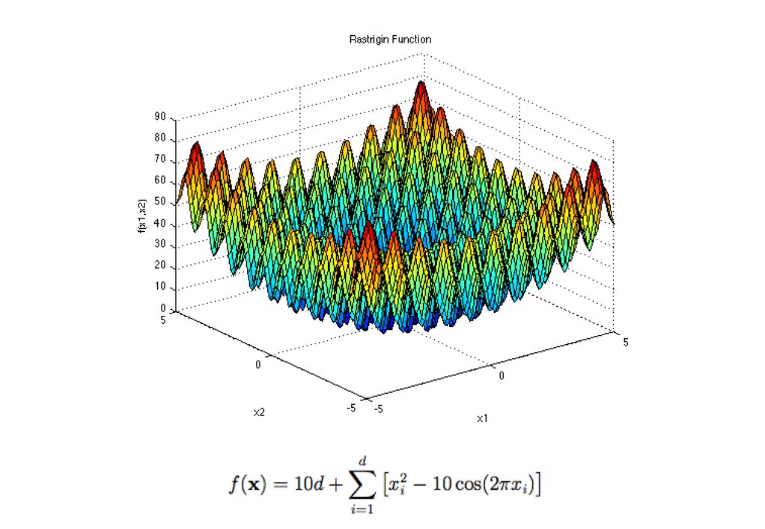
What is the best answer?
2-D Optimization Problem
3-D Optimization problemS

